Slide 1
BlockChain Technology
Hualiang Li
Department of Electrical Engineering
University of Hawaii, Manoa
Notes:
Hi, everyone, my topic is blockchain. You might have heard of bitcoin before, blockchain is the core component of bitcoin. Most of my examples in this presentation use bitcoin, What I would like to mention is that blockchain in nowadays, is not only using in digital currency, or financial institution, it is also used in non-financial application. Which I will briefly talk about by the end of this presentation.

Slide 2
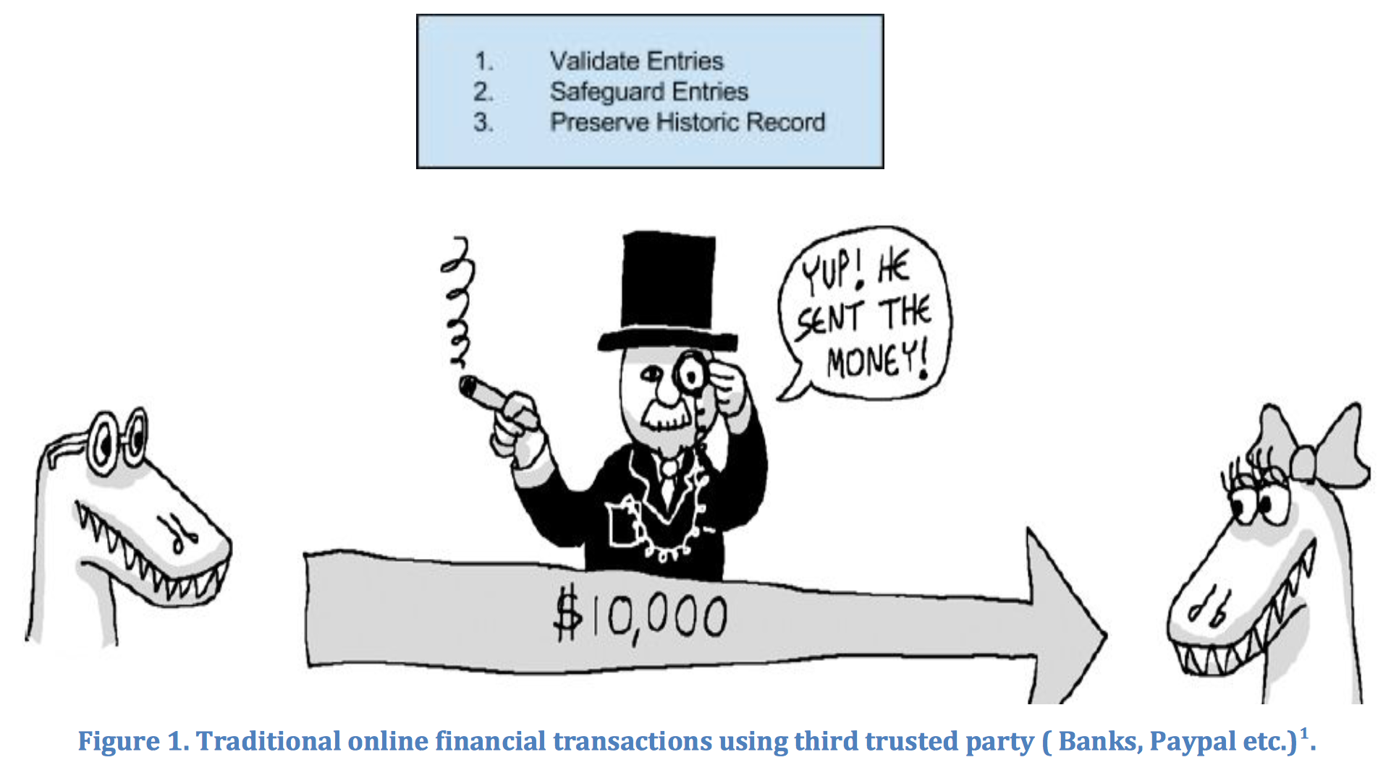
Third-party Involved System
Notes:
You might think that blockchain is far away from you because you never will going to play with bitcoin. But, you are most likely wrong. I believe most if not all of you are using bank account. When you want to transfer you money, or purchase goods with your bank account, this is how you do it. You deposit your money in your bank account, then you transfer the money by telling the bank where I want to send. You might think this is safe. The bank validate… But all this is under assumption that you trust the bank. You believe that your bank will not send my money to others, you believe that your account statement will not be modified by bank, and also you believe that the bank will never go bankcruptcy. What if you are wrong? One good news is that, the blockchain technology can solve these kind of issue.
Internet commerce is exclusively tied to the financial institutions serving as the trusted third party who process and mediate any electronic transaction. The role of trusted third party is to validate, safeguard and preserve transactions. A certain percentage of fraud is unavoidable in online transactions and that needs mediation by financial transactions. This results in high transaction costs.
Bitcoin uses cryptographic proof instead of the trust in the third party for two willing parties to execute an online transaction over the Internet. Each transaction is protected through a digital signature. Each transaction is sent to the “public key” of the receiver digitally signed using the “private key” of the sender. In order to spend money, owner of the cryptocurrency needs to prove the ownership of the “private key”. The entity receiving the digital currency verifies the digital signature –thus ownership of corresponding “private key”--on the transaction using the “public key” of the sender.

Slide 3
Background
“Bitcoin: A Peer-To-Peer Electronic Cash System”, Satoshi Nakamoto, 2008
In a recent interview Rain Lohmus of Estonia’s LHV bank told that they found Blockchain to be the most tested and secure for some banking and finance related applications.
We can envision putting proof of existence of all legal documents, health records, and loyalty payments in the music industry, notary, private securities and marriage licenses in the blockchain.
Notes:
In 2008, Satoshi Nakamoto published a paper titled…, one interesting thing is that the name is believed as a fake name, the real inventor of bitcoin is still remain in the dark. But I will call he or she as Satoshi Nakamoto anyway. In nakamoto’s paper, it first time introduce a method that deals with double spending problem in digital currency, by control the ownership of the currency. You can also think it as a digital signature. An bank CTO think it is secure and tested… Because of the ability of controlling the ownership, we believe it can also be used in legal documents,.. Or even marriage license.

Slide 4
Outline
History and potential usage of BlockChain
Concept of BlockChain
How BlockChain works
Conclusion
Notes:
Here is my outline of this presentation. I talked about … in the previous two slides, next I will talk about the concept of blockchain or what is blockchain, then I will talk about how blockchain works, and try to explain how it can do something anyone else can’t. The presentation will end with a brief conclusion.

Slide 5
What is BlockChain
A blockchain is just a file. A blockchain by itself is just a data structure. That is, how data is logically put together and stored. Other data structures are databases (rows, columns, tables), text files, comma separated values (csv), images, lists, and so on. You can think of a blockchain competing most closely with a database.

Slide 6
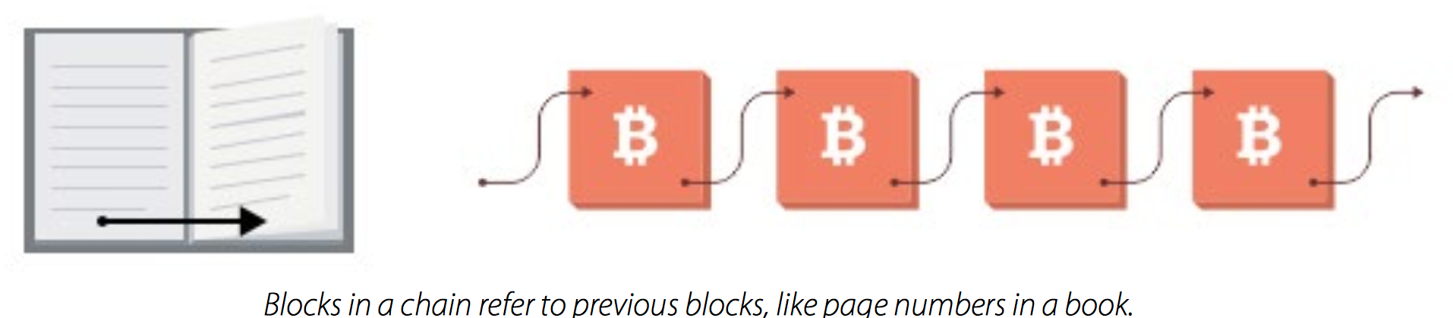
BlockChain v.s Bookpage
Blocks in a chain = pages in a book. For analogy, a book is a chain of pages. Each page in a book contains:
The text: for example the story.
Information about itself: at the top of the page there is usually the title of the book and sometimes the chapter number or title; at the bottom is usually the page number which tells you where you are in the book. This ‘data about data’ is called meta-data.
Notes:
In order to make it easier to understand what block chain looks like, I compare it with bookpage.

Slide 7
BlockChain v.s Bookpage
Similarly in a blockchain block, each block has:
The contents of the block, for example in bitcoin is it the bitcoin transactions, and the miner incentive rewards.
A ‘header’ which contains the data about the block. In bitcoin, the header includes some technical information about the block, a reference to the previous block, and a fingerprint (hash) of the data contained in this block, among other things. This hash is important for ordering.

Slide 8
BlockChain v.s Bookpage
Block ordering in a blockchain.
Page by page. With books, predictable page numbers make it easy to know the order of the pages. If you ripped out all the pages and shuffled them, it would be easy to put them back into the correct order where the story makes sense.
Block by block. With blockchains, each block references the previous block, not by ‘block number’, but by the block’s fingerprint, which is cleverer than a page number because the fingerprint itself is determined by the contents of the block.
Fingerprint or Digital signature:
private key of sender + public key from receiver + transaction message
By using hash function

Slide 9
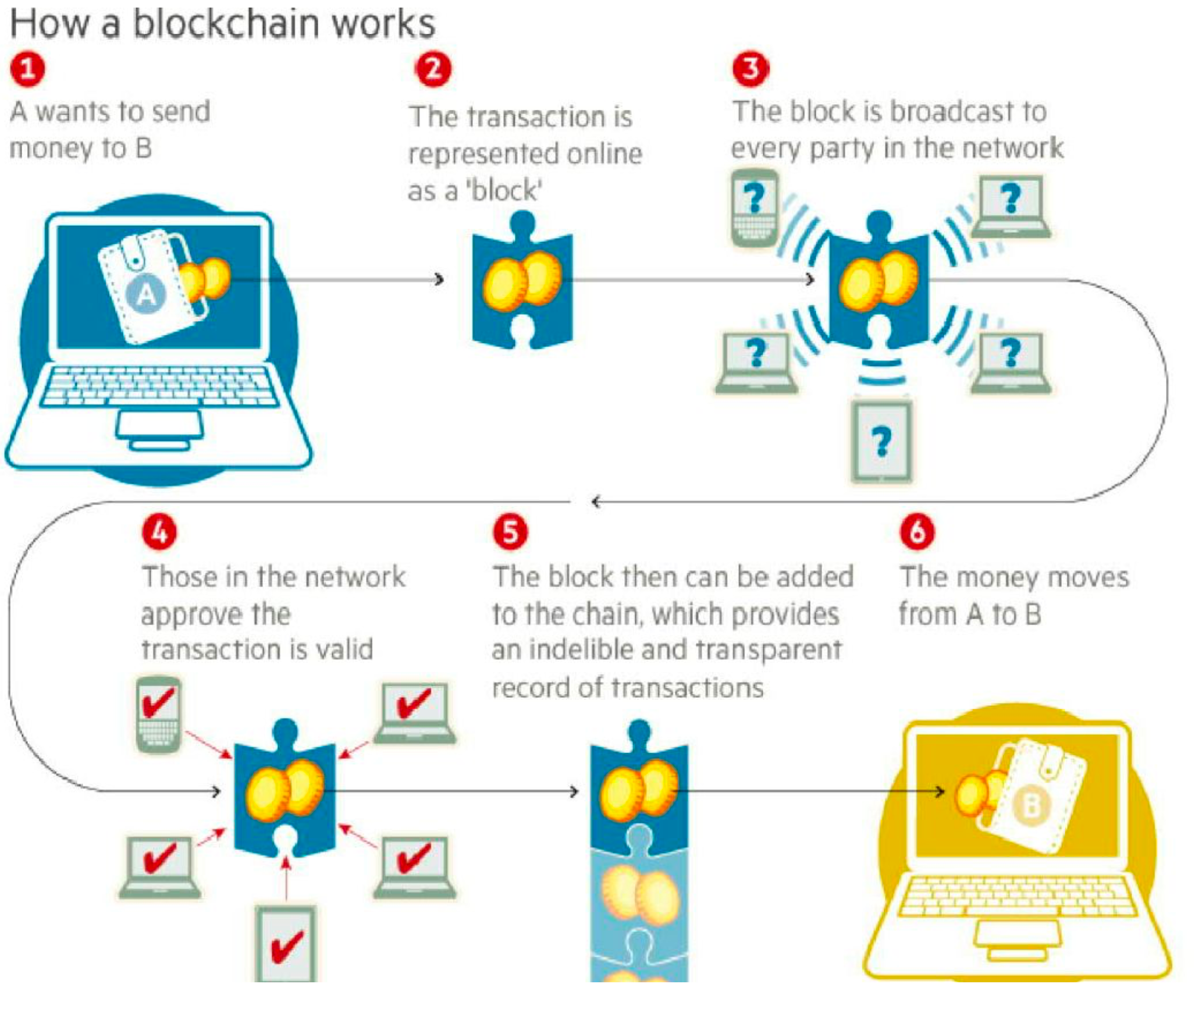
How BlockChain works?

Slide 10
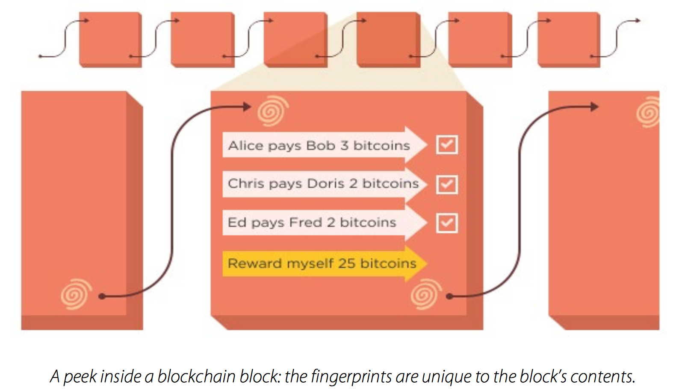
Data Storage View
Internal consistency. By using a fingerprint instead of a timestamp or a numerical sequence, you also get a nice way of validating the data.

Slide 11
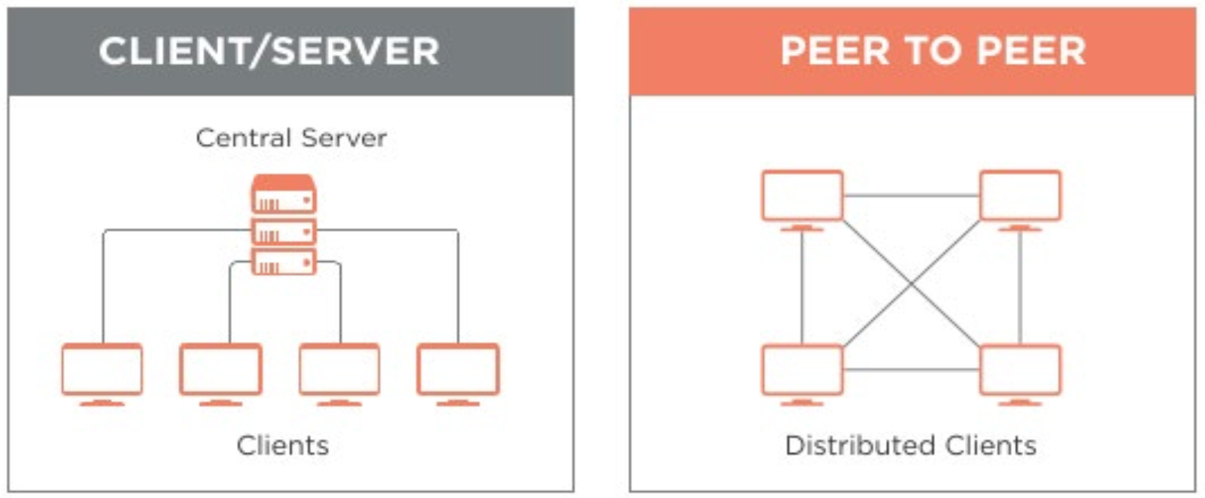
Data Distribution
Peer-to-Peer model (compared to Client/Server model)
Each peer has 100% or almost 100% of data.
Less efficient but more independent.
no central server that can be controlled, so closing down peer-to-peer networks is harder.
Notes:
The way blockchain system distribute data is using P2P model, another famous model is client-server model. As the graph shows…

Slide 12
The problems with Peer-to-Peer
Untrusted peer
How to prevent to be corrupted by bad peers easily?
Problem of agreement or consensus
e.g. different update speed
How to determine the “real” or “true” state of the data?
Notes:
Unfortunately, P2P model has its problem. One of the problems is that there might be bad guy in the network, since other peer could potentially access data from the bad guy, this is a serious issue. Another problem is that, there might be disagreement between peers. For example, when 2 peers have different data, which one should be followed.

Slide 13
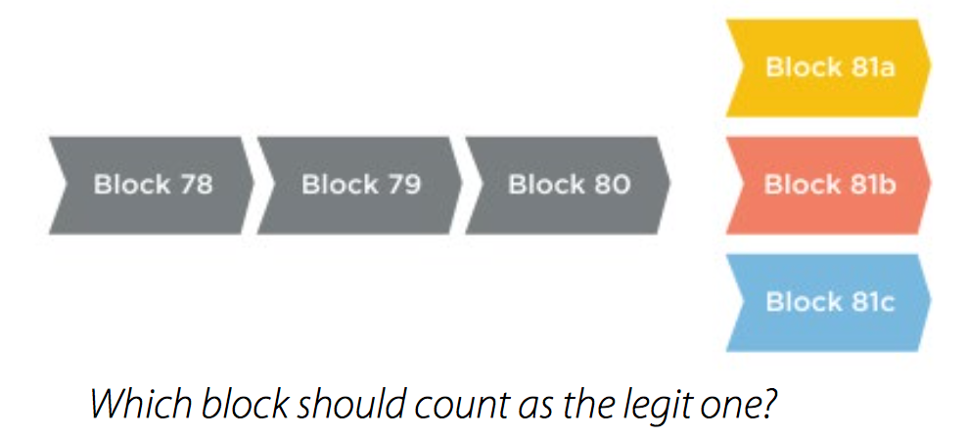
Conflict Resolution
A common conflict is when multiple peers create blocks at roughly the same time. Because blocks take time to be shared across the network, which one should count as the legit block?

Slide 14
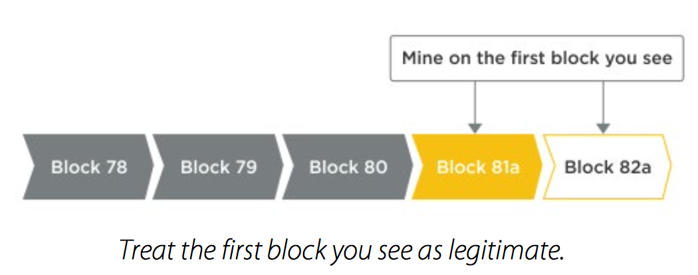
Conflict Resolution
Longest chain rule.
Assume that the first ‘Block 81’ you see is valid. Let’s say you see 81a first. You can start building the next block on that, trying to create 82a:

Slide 15
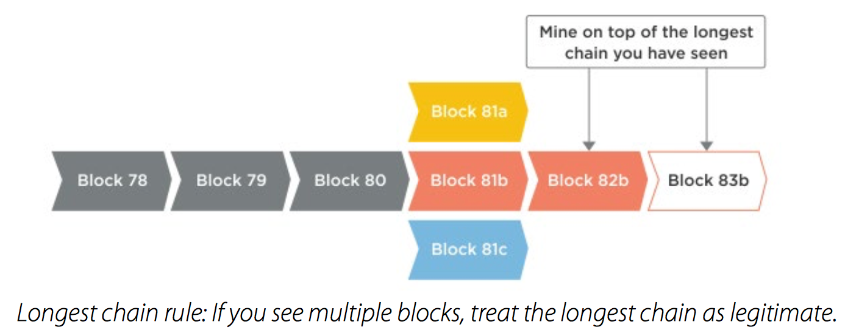
Conflict Resolution
Longest chain rule.
in a few seconds you may see 81b. If you see this, you keep an eye on it. If later you see 82b, the “longest chain rule” says that you should regard the longer ‘b’ chain as the valid one (...80, 81b, 82b) and ignore the shorter chain (...80, 81a). So you stop trying to make 82a and instead start trying to make 83b:

Slide 16
Conflict Resolution
The “longest chain rule” is the rule that the bitcoin blockchain ecosystem uses to resolve these conflicts which are common in distributed networks.
However, with a more centralised or trusted blockchain network, you can make decisions by using a trusted, or senior validator to arbitrate in these cases.

Slide 17
Upgrades: How to change rules
In a private, controlled network where someone has control over upgrades, this is an easy problem to solve.
With BlockChain (2 phases)
1. Suggest the change.
2. Adopt the change.
If the majority of the network choose to run a new version of the software, then new-style blocks will be created faster than the minority, and the minority will be forced to switch or become irrelevant in a “blockchain fork”. So the majority have a good deal of “say” as to what gets implemented.

Slide 18
Control who can write to data
Permissionless vs Permissioned
Permissionless: You don’t need to sign up, log in, or apply to join the network.
Permissioned:
Use blockchain technology in a trusted, private network
Not publish all the rules of what a valid transaction or block looks like.

Slide 19
How to make it harder for hacker?
A problem with a permissionless, or open networks is that they can be attacked by anyone.
Attacker can:
1. Refuse to relay valid transactions to other nodes. 2. Attempt to create blocks that include or exclude specific transactions of his choosing. 3. Attempt to create a ‘longer chain’ of blocks that make previously accepted blocks become ‘orphans’ and not part of the main chain.
Attacker can’t:
1. Create bitcoins out of air.
2. Steal bitcoins from your account. 3. Make payments on your behalf or pretend to be you.

Slide 20
How to make it harder for hacker?
With transactions, the effect a dishonest miner can have is very limited. If the rest of the network is honest, they will reject any invalid transactions coming from them, and they will hear about valid transactions from other honest nodes, even if they are refusing to pass them on.
With blocks, if the malicious attacker has sufficient block creation power (and this is what it all hinges on), he can delay your transaction by refusing to include it in his blocks. However, your transaction will still be known by other honest nodes as an ‘unconfirmed transaction’, and they will include it in their blocks.
Worse case, is if the malicious attacker can create a longer chain of blocks than the rest of the network, and invoking the “longest chain rule” to kick out the shorter chains. This lets the attacker unwind a transaction.

Slide 21
Double Spend Problem
Suppose you did this:
1. Create two payments with the same bitcoins: one to an online retailer, the other to yourself (another address you control).
2. Only broadcast the payment that pays the retailer. 3. When the payment gets added in an honest block, the retailer sends you goods. 4. Secretly create a longer chain of blocks which excludes the payment to the retailer, and includes the payment to yourself.
5. Publish the longer chain. If the other nodes are playing by the “longest chain” rule, then they will ignore the honest block with the retailer payment, and continue to build on your longer chain. The honest block is said to be ‘orphaned’ and does not exist to all intents and purposes.
6. The original payment to the retailer will be deemed invalid by the honest nodes because those bitcoins have already been spent (in your longer chain).

Slide 22
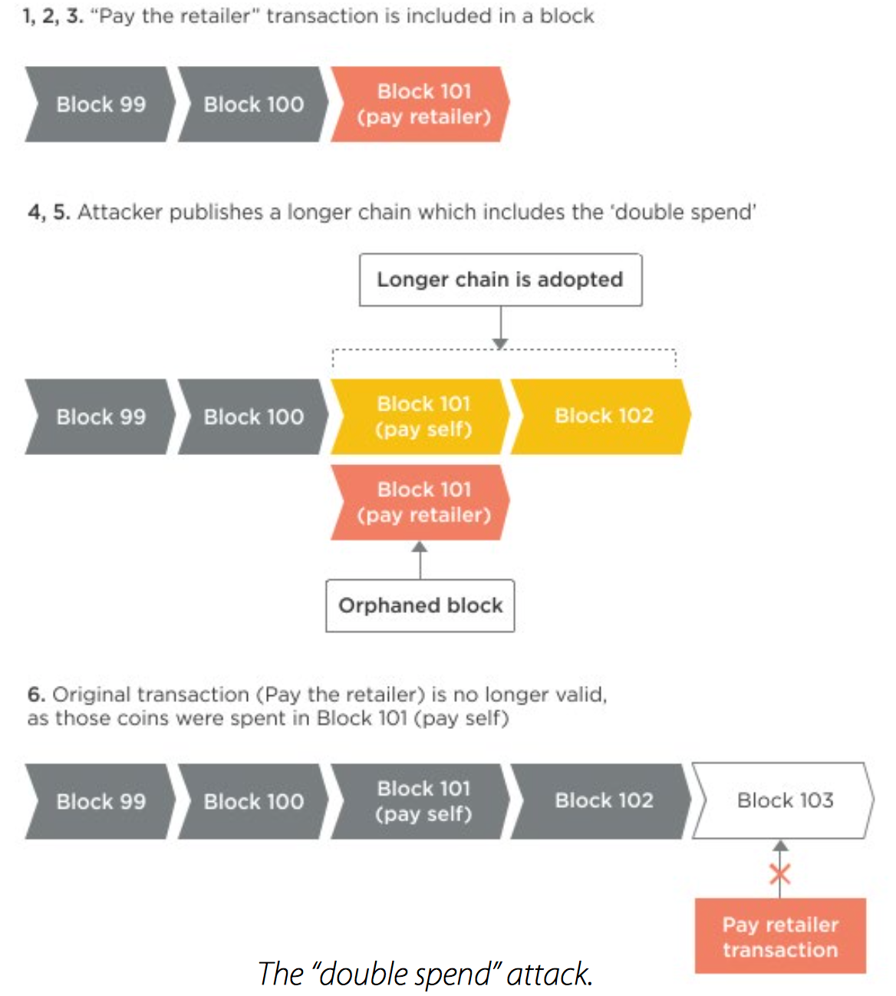
Double Spend Problem

Slide 23
Double Spend Problem
Essentially you want to make it hard, or expensive for malicious attackers to add blocks. In bitcoin, this is done by making it computationally expensive to add blocks. Computationally expensive means “takes a lot of computer processing power” and translates to financially expensive (as computers need to be bought then run and maintained).

Slide 24
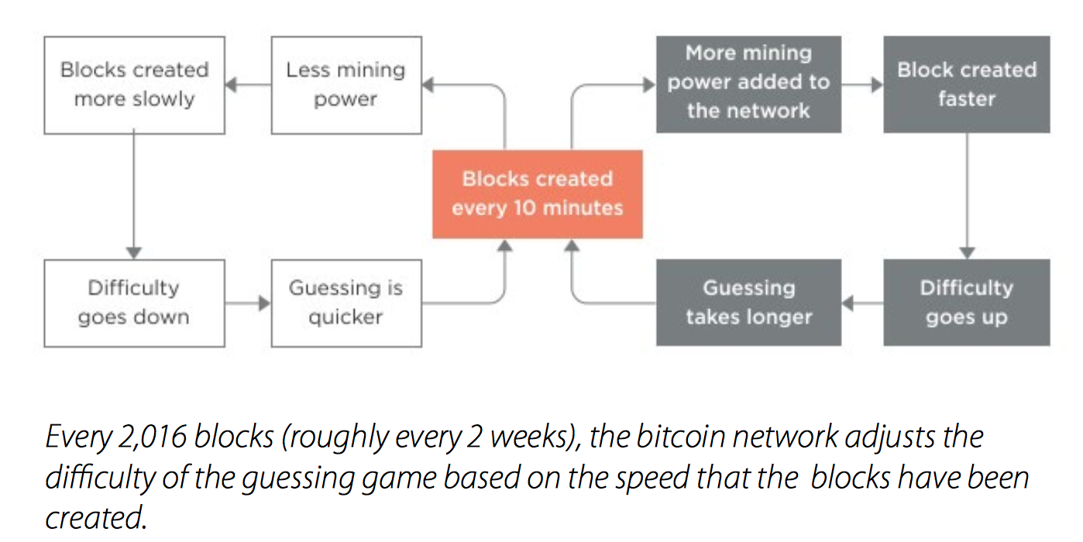
Double Spend Problem
The computation itself is a guessing game where block-makers need to guess a number, which when crunched with the rest of the block data contents, results in a hash / fingerprint that is smaller than a certain number. That number is related to the ‘difficulty’ of mining which is related to the total network processing power. The more computers joining in to process blocks, the harder it gets, in a self-regulating cycle.

Slide 25
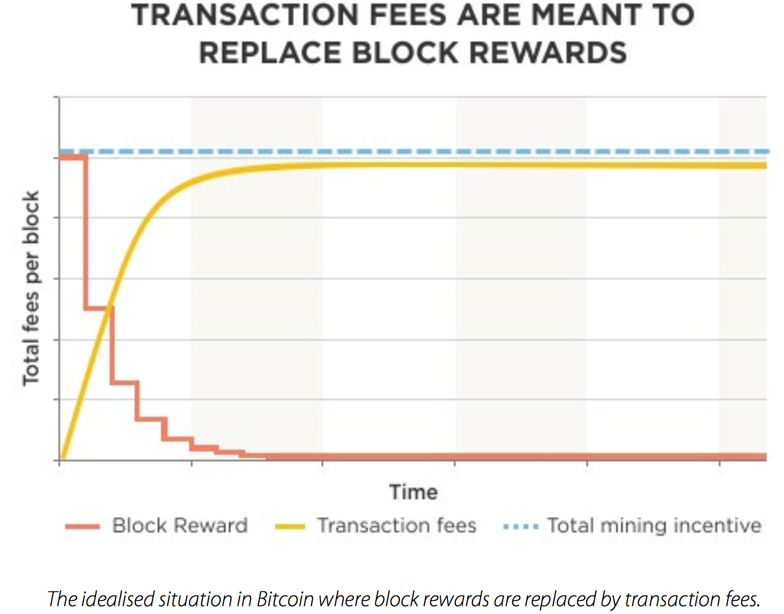
INCENTIVES: How do you pay validators?
Because of bitcoin’s ‘public’ structure, it needs a defence against malicious attackers and so uses “proof of work” to make it computationally difficult to add a block. This has created a cost (equipment and running costs) of mining and therefore a need for incentivisation.

Slide 26
Conclusion
It is useful to understand blockchains in the context of bitcoin, but you should not assume that all blockchain ecosystems need bitcoin mechanisms such as proof of work, longest chain rule, etc. Bitcoin is the first attempt at maintaining a decentralised, public ledger with no formal control or governance. There are significant challenges involved.
On the other hand, private distributed ledgers and blockchains can be deployed to solve other sets of problems. As ever, there are tradeoffs and pros and cons to each solution, and you need to consider these individually for each individual use case.

Slide 27
Reference
http://scet.berkeley.edu/wp-content/uploads/BlockchainPaper.pdf
Nakamoto, Satoshi. "Bitcoin: A peer-to-peer electronic cash system." (2008).
http://www.slideshare.net/philippecamacho/smart-contracts
http://startupmanagement.org/2014/12/16/the-ultimate-list-of-bitcoin-and-blockchain-white-papers/
https://en.wikipedia.org/wiki/Blockchain_(database)

